Slide 1
Session 4 – Web Session
Notes:
There are many ways to make session:
Cookies
URL rewriting
Hidden filed
Session Object

Slide 2
Agenda - Handling Cookies
The potential of cookies
The problems with cookies
Sending cookies to browser
Reading cookies from browser
Simple cookie-handling servlets
Cookie utilities
Methods in the Cookie API
A customized search engine front end

Slide 3
The Potential of Cookies
Idea
  Servlet sends a simple name and value to client.
  Client returns same name and value when it connects to same site (or same domain, depending on cookie settings).
Typical Uses of Cookies
  Identifying a user during an e-commerce session
    Servlets have a higher-level API for this task
  Avoiding username and password
  Customizing a site
  Focusing advertising

Slide 4
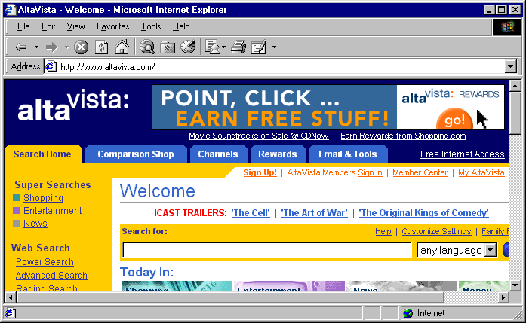
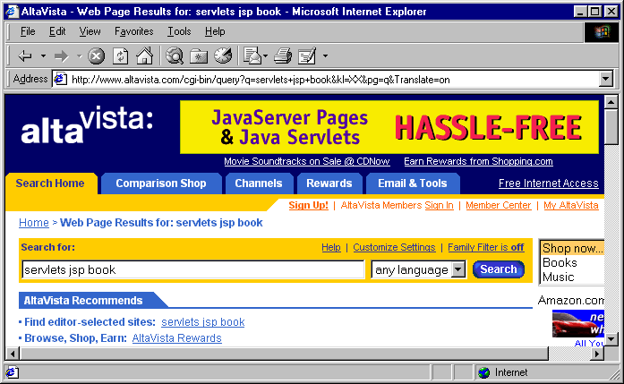
Cookies and Focused Advertising

Slide 5
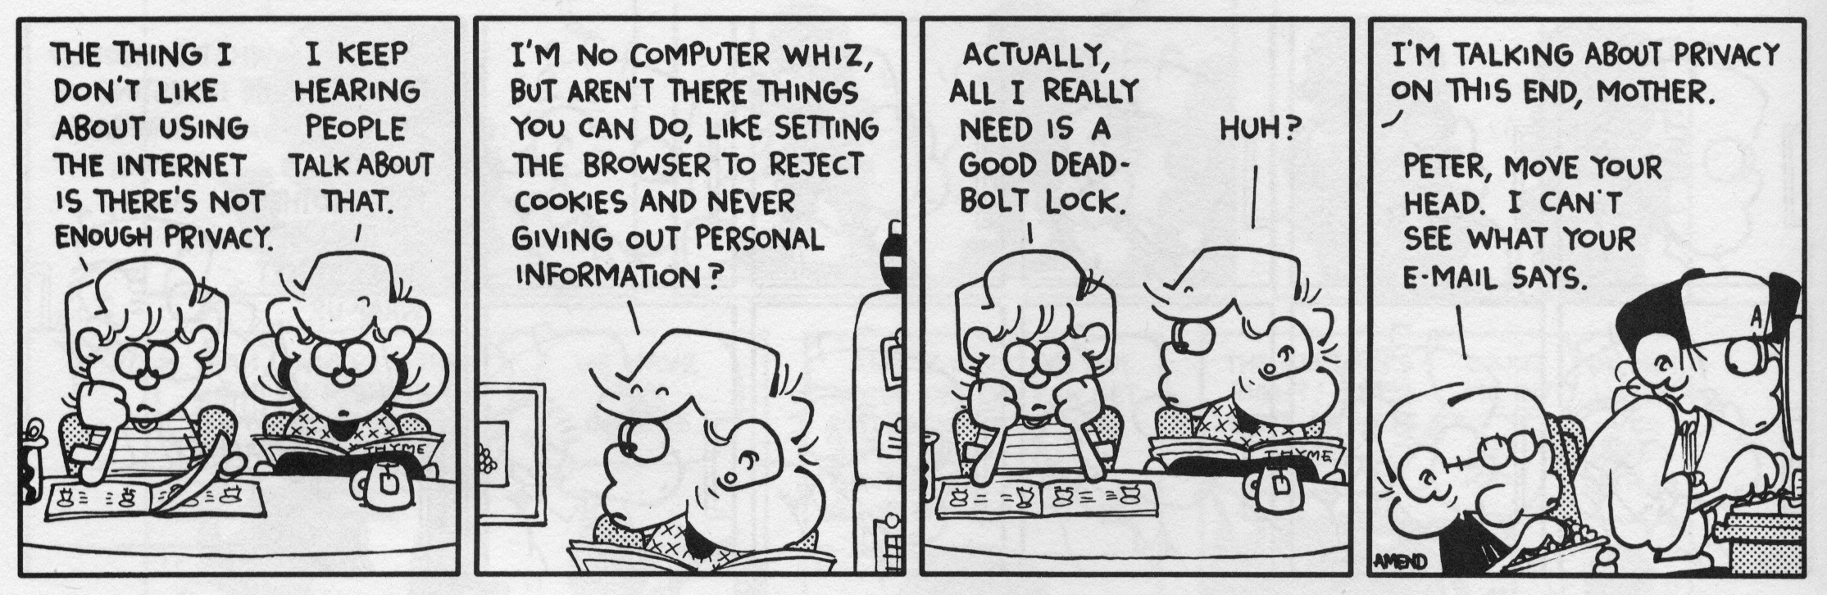
Cookies and Privacy
FoxTrot © 1998 Bill Amend. Reprinted with permission of
Universal Press Syndicate. All rights reserved.

Slide 6
Some Problems with Cookies
The problem is privacy, not security.
  Servers can remember your previous actions
  If you give out personal information, servers can link that information to your previous actions
  Servers can share cookie information through use of a cooperating third party like doubleclick.net
  Poorly designed sites store sensitive information like credit card numbers directly in cookie
  JavaScript bugs let hostile sites steal cookies (old browsers)
Moral for servlet authors
  If cookies are not critical to your task, avoid servlets that totally fail when cookies are disabled
  Don't put sensitive info in cookies

Slide 7
Sending Cookies to Browser
Standard approach:
  Cookie c = new Cookie("name", "value");
  c.setMaxAge(...); // Means cookie persists on disk
  // Set other attributes.
  response.addCookie(c);
Simplified approach:
  Use LongLivedCookie class:
  public class LongLivedCookie extends Cookie {
  public static final int SECONDS_PER_YEAR =
  60*60*24*365;
  public LongLivedCookie(String name, String value) {
  super(name, value);
  setMaxAge(SECONDS_PER_YEAR);
  }
  }

Slide 8
Reading Cookies from Browser
Standard approach:
  Cookie[] cookies = request.getCookies();
  if (cookies != null) {
  for(int i=0; i<cookies.length; i++) {
  Cookie c = cookies[i];
  if (c.getName().equals("someName")) {
  doSomethingWith(c);
  break;
  }
  }
  }
Simplified approach:
  Extract cookie or cookie value from cookie array by using ServletUtilities.getCookieValue or ServletUtilities.getCookie

Slide 9
Simple Cookie-Setting Servlet
public class SetCookies extends HttpServlet {
public void doGet(HttpServletRequest request,
HttpServletResponse response)
throws ServletException, IOException {
for(int i=0; i<3; i++) {
Cookie cookie = new Cookie("Session-Cookie-" + i,
"Cookie-Value-S" + i);
response.addCookie(cookie);
cookie = new Cookie("Persistent-Cookie-" + i,
"Cookie-Value-P" + i);
cookie.setMaxAge(3600);
response.addCookie(cookie);
}
response.setContentType("text/html");
PrintWriter out = response.getWriter();
out.println(...);

Slide 10
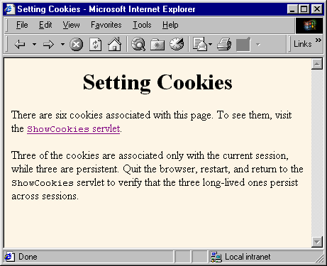
Result of Cookie-Setting Servlet

Slide 11
Simple Cookie-Viewing Servlet
public class ShowCookies extends HttpServlet {
public void doGet(HttpServletRequest request,
HttpServletResponse response)
throws ServletException, IOException {
response.setContentType("text/html");
PrintWriter out = response.getWriter();
String title = "Active Cookies";
out.println(ServletUtilities.headWithTitle(title) +
"<BODY BGCOLOR=\"#FDF5E6\">\n" +
"<H1 ALIGN=\"CENTER\">" + title +
"</H1>\n" +
"<TABLE BORDER=1 ALIGN=\"CENTER\">\n" +
"<TR BGCOLOR=\"#FFAD00\">\n" +
" <TH>Cookie Name\n" +
" <TH>Cookie Value");

Slide 12
Simple Cookie-Viewing Servlet (Continued)
Cookie[] cookies = request.getCookies();
if (cookies != null) {
Cookie cookie;
for(int i=0; i<cookies.length; i++) {
cookie = cookies[i];
out.println("<TR>\n" +
" <TD>" + cookie.getName() + "\n" +
" <TD>" + cookie.getValue());
}
}
out.println("</TABLE></BODY></HTML>");
}
}

Slide 13
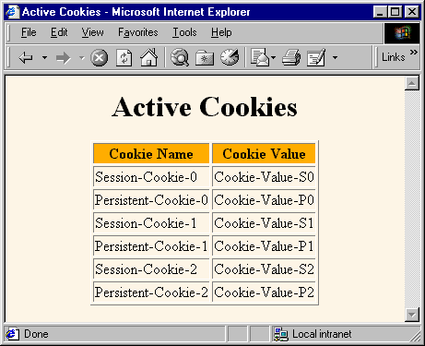
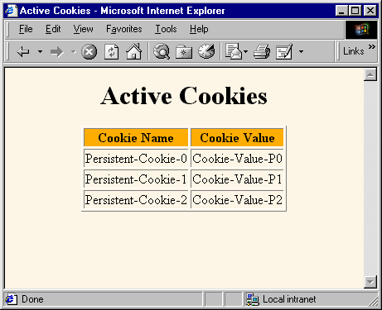
Result of Cookie-Viewer (Before & After Restarting Browser)

Slide 14
Cookie Utilities
Problem
  getCookies returns an array of cookies
  You almost always only care about one particular cookie
Solution
  Static methods to
    Extract a cookie value given a cookie name
    (default value if no match)
    Extract a Cookie object given a cookie name
    (null if no match)

Slide 15
ServletUtilities.getCookieValue
public static String getCookieValue(Cookie[] cookies,
String cookieName,
String defaultVal) {
if (cookies != null) {
for(int i=0; i<cookies.length; i++) {
Cookie cookie = cookies[i];
if (cookieName.equals(cookie.getName()))
return(cookie.getValue());
}
}
return(defaultVal);
}

Slide 16
ServletUtilities.getCookie
public static Cookie getCookie(Cookie[] cookies,
String cookieName) {
if (cookies != null) {
for(int i=0; i<cookies.length; i++) {
Cookie cookie = cookies[i];
if (cookieName.equals(cookie.getName()))
return(cookie);
}
}
return(null);
}

Slide 17
Methods in the Cookie API
getDomain/setDomain
  Lets you specify domain to which cookie applies. Current host must be part of domain specified.
getMaxAge/setMaxAge
  Gets/sets the cookie expiration time (in seconds). If you fail to set this, cookie applies to current browsing session only. See LongLivedCookie helper class given earlier.
getName
  Gets the cookie name. There is no setName method; you supply name to constructor. For incoming cookie array, you use getName to find the cookie of interest.

Slide 18
Methods in the Cookie API (Continued)
getPath/setPath
  Gets/sets the path to which cookie applies. If unspecified, cookie applies to URLs that are within or below directory containing current page.
getSecure/setSecure
  Gets/sets flag indicating whether cookie should apply only to SSL connections or to all connections.
getValue/setValue
  Gets/sets value associated with cookie. For new cookies, you supply value to constructor, not to setValue. For incoming cookie array, you use getName to find the cookie of interest, then call getValue on the result. If you set the value of an incoming cookie, you still have to send it back out with response.addCookie.

Slide 19
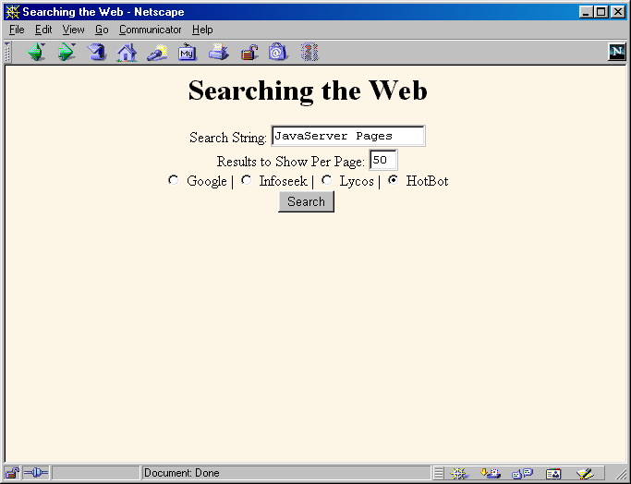
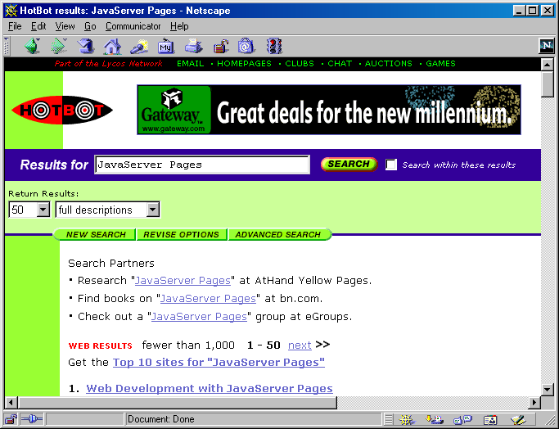
A Customized Search Engine Interface
Front end
remembers
settings for
search engine,
search string,
and hits per
page
  Front end
  uses cookies
  Back end
  sets cookies
  In real life,
  don't really
  show previous
  queries!

Slide 20
Front End to SearchEngines Servlet
public class SearchEnginesFrontEnd extends HttpServlet {
public void doGet(HttpServletRequest request,
HttpServletResponse response)
throws ServletException, IOException {
Cookie[] cookies = request.getCookies();
String searchString =
ServletUtilities.getCookieValue(cookies,
"searchString",
"Java Programming");
String numResults =
ServletUtilities.getCookieValue(cookies,
"numResults",
"10");
String searchEngine =
ServletUtilities.getCookieValue(cookies,
"searchEngine",
"google");

Slide 21
Front End to SearchEngines Servlet (Continued)
...
out.println
(...
"<FORM ACTION=\"/servlet/" +
"coreservlets.CustomizedSearchEngines\">\n" +
"<CENTER>\n" +
"Search String:\n" +
"<INPUT TYPE=\"TEXT\" NAME=\"searchString\"\n" +
" VALUE=\"" + searchString + "\"><BR>\n" +
"Results to Show Per Page:\n" +
"<INPUT TYPE=\"TEXT\" NAME=\"numResults\"\n" +
" VALUE=" + numResults + " SIZE=3><BR>\n" +
"<INPUT TYPE=\"RADIO\" NAME=\"searchEngine\"\n" +
" VALUE=\"google\"" +
checked("google", searchEngine) + ">\n" +
...);

Slide 22
Customized SearchEngines Servlet (Back End)
public class CustomizedSearchEngines extends HttpServlet {
public void doGet(HttpServletRequest request,
HttpServletResponse response)
throws ServletException, IOException {
String searchString =
request.getParameter("searchString");
if ((searchString == null) ||
(searchString.length() == 0)) {
reportProblem(response, "Missing search string.");
return;
}
Cookie searchStringCookie =
new LongLivedCookie("searchString", searchString);
response.addCookie(searchStringCookie);
...
}
}

Slide 23
Summary
Cookies involve name/value pairs sent from server to browser and returned when the same page, site, or domain is visited later
Let you
  Track sessions (use higher-level API)
  Permit users to avoid logging in at low-security sites
  Customize sites for different users
  Focus content or advertising
Setting cookies
  Call Cookie constructor, set age, call response.addCookie
Reading cookies
  Call request.getCookies, check for null, look through array for matching name, use associated value

Slide 24
Agenda - Session Tracking
The purpose of session tracking
Rolling your own session tracking
The session tracking API
Per-client access counts
Shopping carts and online stores

Slide 25
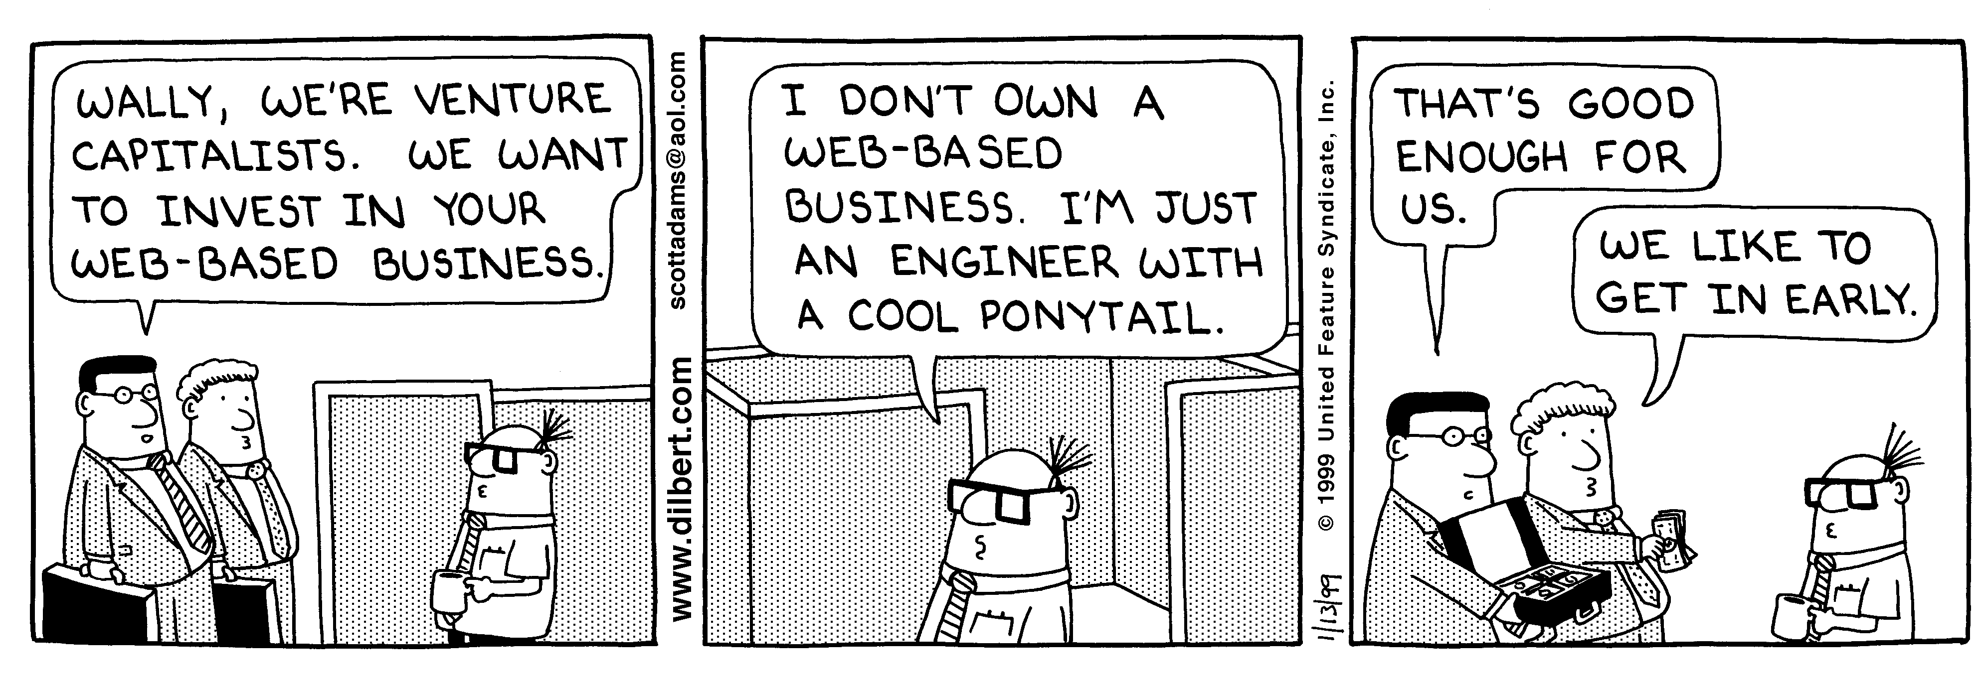
Session Tracking and E-Commerce
Why session tracking?
  When clients at on-line store add item to their shopping cart, how does server know what’s already in cart?
  When clients decide to proceed to checkout, how can server determine which previously created cart is theirs?
Dilbert used with permission of United Syndicates Inc.

Slide 26
Rolling Your Own Session Tracking: Cookies
Idea: associate cookie with data on server
  String sessionID = makeUniqueString();
  Hashtable sessionInfo = new Hashtable();
  Hashtable globalTable = findTableStoringSessions();
  globalTable.put(sessionID, sessionInfo);
  Cookie sessionCookie =
  new Cookie("JSESSIONID", sessionID);
  sessionCookie.setPath("/");
  response.addCookie(sessionCookie);
Still to be done:
  Extracting cookie that stores session identifier
  Setting appropriate expiration time for cookie
  Associating the hash tables with each request
  Generating the unique session identifiers

Slide 27
Rolling Your Own Session Tracking: URL-Rewriting
Idea
  Client appends some extra data on the end of each URL that identifies the session
  Server associates that identifier with data it has stored about that session
  E.g., http://host/path/file.html;jsessionid=1234
Advantage
  Works even if cookies are disabled or unsupported
Disadvantages
  Lots of tedious processing
  Must encode all URLs that refer to your own site
  Links from other sites and bookmarks can fail

Slide 28
Rolling Your Own Session Tracking: Hidden Form Fields
Idea:
  <INPUT TYPE="HIDDEN" NAME="session" VALUE="...">
Advantage
  Works even if cookies are disabled or unsupported
Disadvantages
  Lots of tedious processing
  All pages must be the result of form submissions

Slide 29
The Session Tracking API
Session objects live on the server
Automatically associated with client via cookies or URL-rewriting
  Use request.getSession(true) to get either existing or
  new session
    Behind the scenes, the system looks at cookie or URL extra info and sees if it matches the key to some previously stored session object. If so, it returns that object. If not, it creates a new one, assigns a cookie or URL info as its key, and returns that new session object.
Hashtable-like mechanism lets you store arbitrary objects inside session
  setAttribute (putValue in 2.1) stores values
  getAttribute (getValue in 2.1) retrieves values

Slide 30
Accessing Session Data
HttpSession session = request.getSession(true);
ShoppingCart cart =
(ShoppingCart)session.getAttribute("shoppingCart");
if (cart == null) { // No cart already in session
cart = new ShoppingCart();
session.setAttribute("shoppingCart", cart);
}
doSomethingWith(cart);

Slide 31
HttpSession Methods
getAttribute (getValue in old servlet spec 2.1)
  Extracts a previously stored value from a session object. Returns null if no value is associated with given name.
setAttribute (putValue in ver. 2.1)
  Associates a value with a name. Monitor changes: values implement HttpSessionBindingListener.
removeAttribute (removeValue in ver. 2.1)
  Removes values associated with name.
getAttributeNames (getValueNames in 2.1)
  Returns names of all attributes in the session.
getId
  Returns the unique identifier.

Slide 32
HttpSession Methods (Continued)
isNew
  Determines if session is new to client (not to page)
getCreationTime
  Returns time at which session was first created
getLastAccessedTime
  Returns time at which session was last sent from client
getMaxInactiveInterval, setMaxInactiveInterval
  Gets or sets the amount of time session should go without access before being invalidated
invalidate
  Invalidates the session and unbinds all
  objects associated with it

Slide 33
A Servlet Showing Per-Client Access Counts
public void doGet(HttpServletRequest request,
HttpServletResponse response)
throws ServletException, IOException {
response.setContentType("text/html");
PrintWriter out = response.getWriter();
String title = "Session Tracking Example";
HttpSession session = request.getSession(true);
String heading;
Integer accessCount =
(Integer)session.getAttribute("accessCount");
if (accessCount == null) {
accessCount = new Integer(0);
heading = "Welcome, Newcomer";
} else {
heading = "Welcome Back";
accessCount = new Integer(accessCount.intValue() + 1);
}
session.setAttribute("accessCount", accessCount);

Slide 34
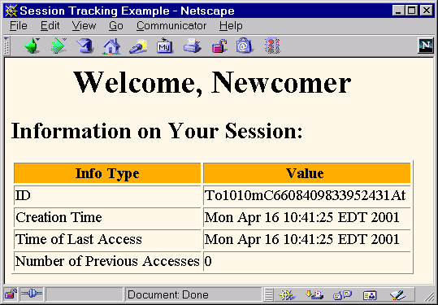
First Visit to ShowSession Servlet

Slide 35
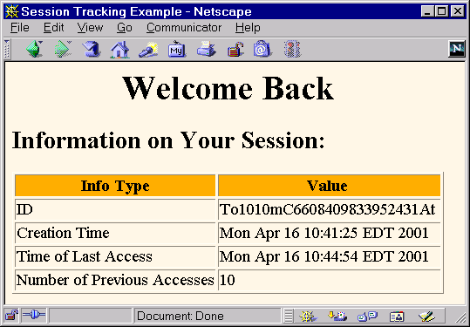
Eleventh Visit to ShowSession Servlet

Slide 36
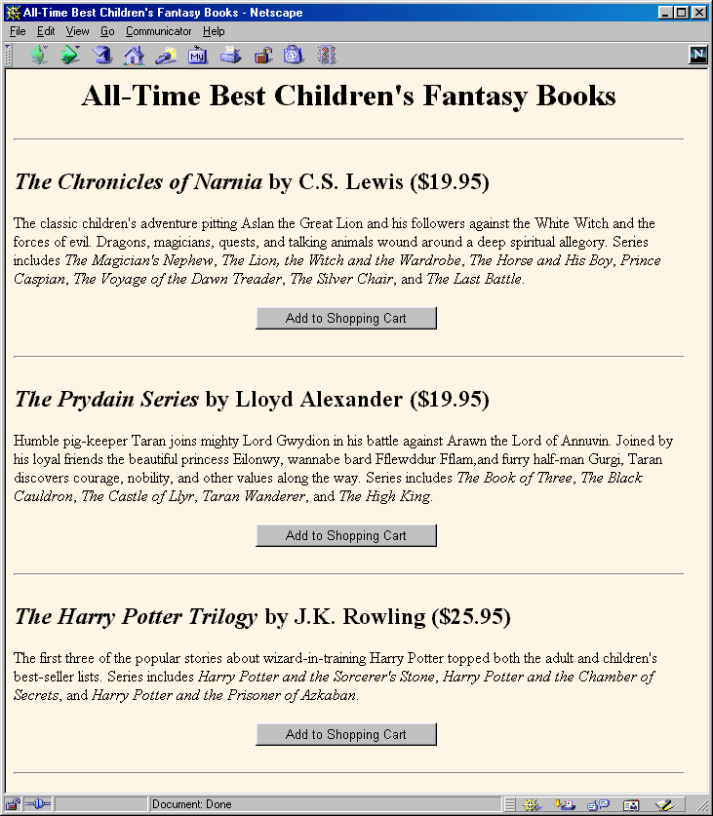
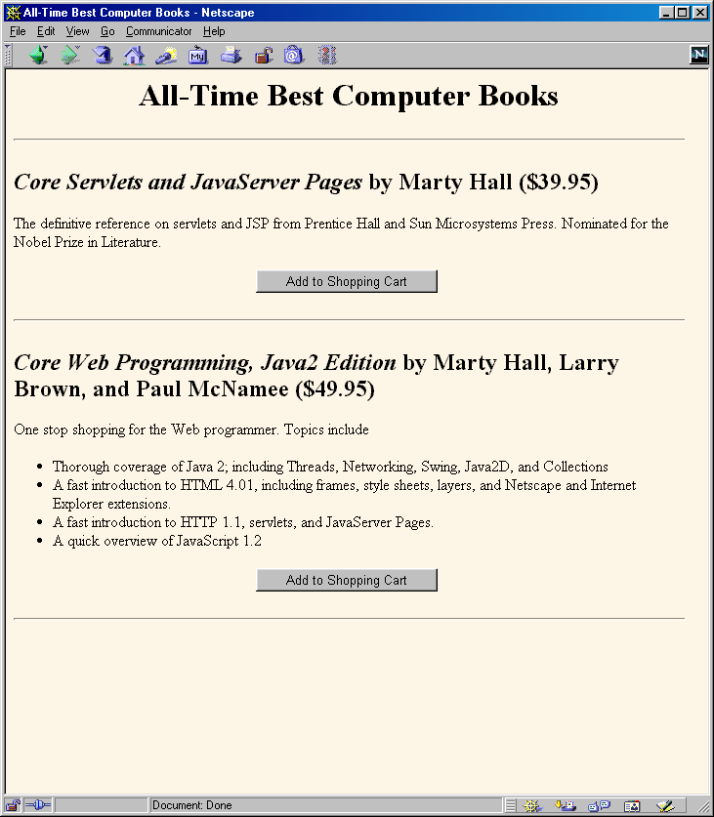
Session Tracking and Shopping Carts

Slide 37
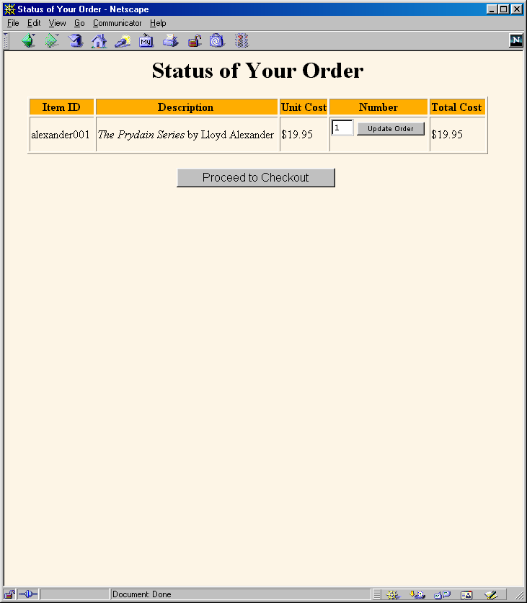
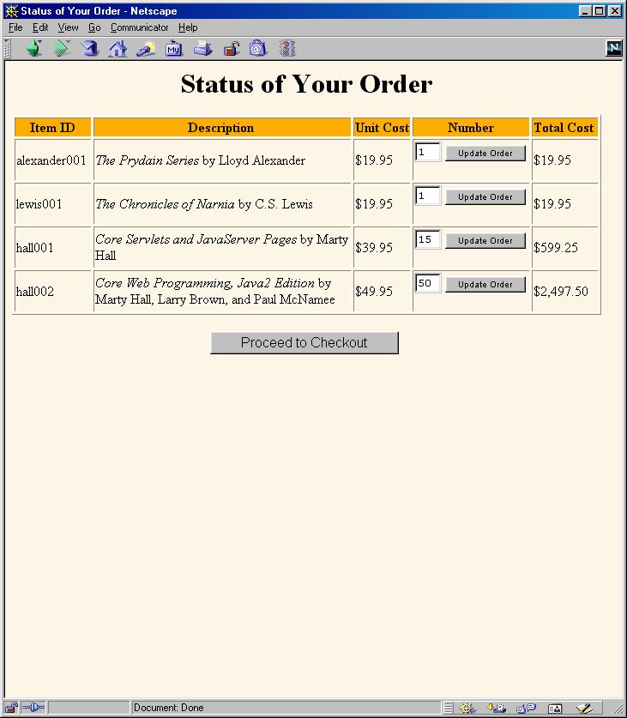
Session Tracking and Shopping Carts (Continued)

Slide 38
What Changes if Server Uses URL Rewriting?
Session tracking code:
  No change
Code that generates hypertext links back to same site:
  Pass URL through response.encodeURL.
    If server is using cookies, this returns URL unchanged
    If server is using URL rewriting, this appends the session info to the URL
    E.g.:
    String url = "order-page.html";
    url = response.encodeURL(url);
Code that does sendRedirect to same site:
  Pass URL through response.encodeRedirectURL

Slide 39
Summary
Although it usually uses cookies behind the scenes, the session tracking API is higher-level and easier to use than the cookie API
  If server supports URL-rewriting, your code unchanged
Session information lives on server
  Cookie or extra URL info associates it with a user
Obtaining session
  request.getSession(true)
Associating values with keys
  session.setAttribute (or session.putValue)
Finding values associated with keys
  session.getAttribute (or session.getValue)
    Always check if this value is null

